Slide 1
Key Stage 2 Tests
Brampton Village Primary School
March 2018

Slide 2
SATs week Monday 14th May – Thursday 17th May 2018

Slide 3
KS2 English Reading test
The reading test is a single paper with questions based on three passages of text.
Your child will have one hour, including reading time, to complete the test.
There will be a selection of question types, including:
Ranking/ordering, e.g. ‘Number the events below to show the order in which they happen in the story’
Labelling, e.g. ‘Label the text to show the title of the story’
Find and copy, e.g. ‘Find and copy one word that suggests what the weather is like in the story’
Short constructed response, e.g. ‘What does the bear eat?’
Open-ended response, e.g. ‘Look at the sentence that begins Once upon a time. How does the writer increase the tension throughout this paragraph? Explain fully, referring to the text in your answer.’
Mixture of genres
The least demanding text will come first, the texts will then increase in difficulty.

Slide 4
Sample Questions

Slide 5
KS2 Writing Assessments
There is no written ‘test’.
No flexibility for pupils who struggle to spell.
Handwriting – unless the child has a physical difficulty, it must be legible.
Writing judgements are based on teacher assessment only but may be moderated by Local Authority representatives.
Throughout the year we have been, and will continue to, assess the children’s writing.
Teachers assess whether children are working towards, at or at greater depth within the expected standard.
This continues until the end of the year.

Slide 6
KS2 Grammar, Punctuation and Spelling
Paper 1 – Short answer grammar and punctuation
45 minutes
Paper 2 – Spelling
Children complete 20 missing word spellings presented in a sentence.
Approximately 15 minutes to complete the test
The grammar and punctuation test will include two sub-types of questions:
Selected response, e.g. ‘Identify the adjectives in the sentence below’
Constructed response, e.g. ‘Correct/complete/rewrite the sentence below,’ or, ‘The sentence below has an apostrophe missing. Explain why it needs an apostrophe.’

Slide 7
Sample Questions
Grammar, Punctuation and Vocabulary Paper

Slide 8
KS2 Mathematics Test
Children sit three papers in maths:
Paper 1: arithmetic, 30 minutes
Papers 2 and 3: reasoning, 40 minutes per paper
Paper 1 will consist of fixed response questions, where children have to give the correct answer to calculations, including long multiplication and division. This replaces the mental mathematics test
Papers 2 and 3 will involve a number of question types, including:
Multiple choice
True or false
Constrained questions, e.g. giving the answer to a calculation, drawing a shape or completing a table or chart
Less constrained questions, where children will have to explain their approach for solving a problem
Questions assess arithmetic knowledge covering:
Addition / Subtraction
Short and long multiplication
Short and long division
Fractions
Decimals
Percentages

Slide 9
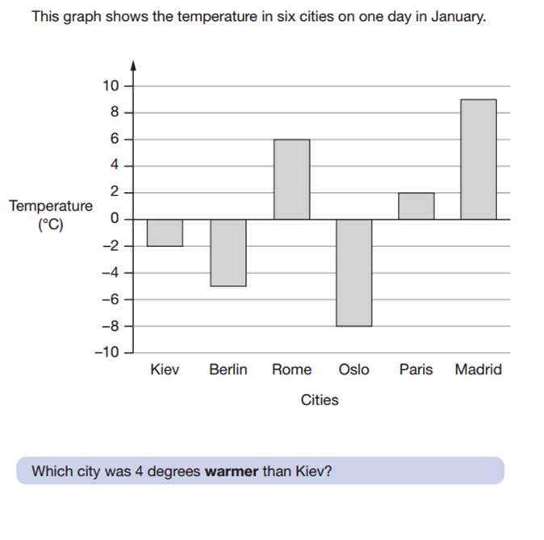
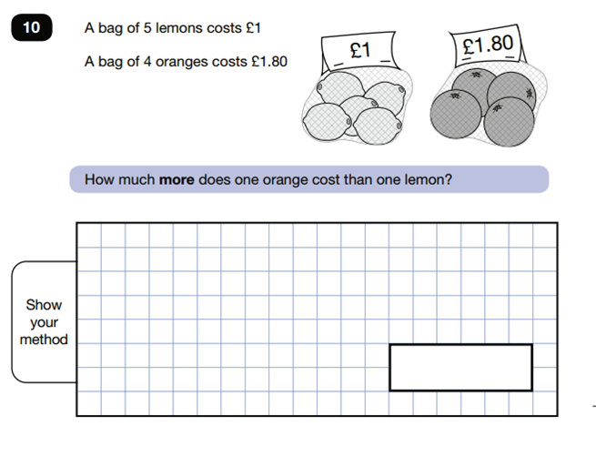

Slide 10
Reporting results: Scaled scores
Parents and schools will be presented with a scaled score
A scaled score of 100 will represent the ‘expected standard’
A pupil’s scaled score will be based on their raw score and it will be translated into a scaled score using a conversion table
For writing you will be told if your child is:
working towards the expected standard
working at the expected standard
working at greater depth within the expected standard
2016 figures

Slide 11
How To Help Your Child
First and foremost, support and reassure your child that there is nothing to worry about.
They are being taught everything they need to know at school.
They should always just try their best... that’s all we ask of them.
Praise and encourage them.
Ensure that your child has the best possible attendance at school.
Support them with any homework tasks.
It is always good to practise reading, spelling and arithmetic, eg, times tables.
Talk with your child about what they have learnt at school and what books they are reading (characters, plot, their opinions etc).
Make sure your child has a good sleep and healthy breakfast every morning.

