Slide 1
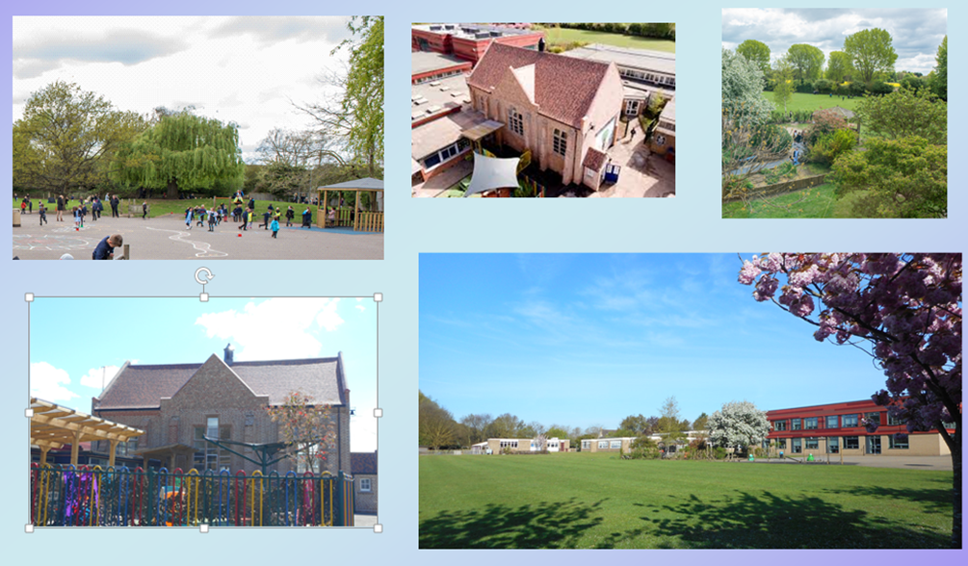
Welcome

Slide 2
How are you feeling?

Slide 4
Express Yourself

Slide 5
We all have mental health.
Mental health is about our feelings, our thinking, our emotions and our moods.

Slide 6
Everybody knows how to look after physical health…
…looking after our mental health is just as important.

Slide 8
We all have feelings that come and go everyday. These are small feelings.
grumpy
nervous
happy
sad

Slide 9
Big feelings are feelings that go on for a very long time and stop us doing what we want in life.
They can affect our mental health.

Slide 10
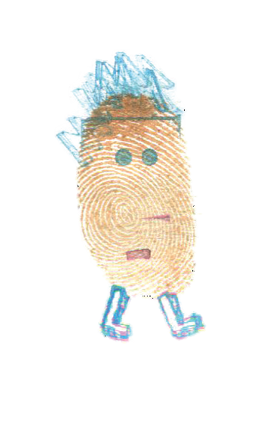
Who can help us?
teacher
parents
friend

Slide 12
How do you share your feelings?
I’ve got something to say

Slide 13
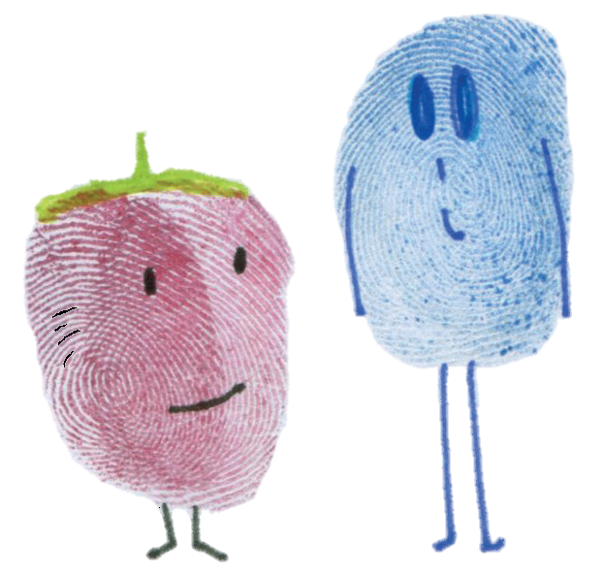
Do you have time to speak about something?

Slide 14
I have something important I would like to talk to you about…

Slide 16
sit side by side
make them feel comfortable

Slide 17
always listen carefully
help them find an adult if necessary

Slide 18
Remember if your feelings are getting too big to cope with on your own and you feel you want to change things…
…talking to someone you trust might really help.

Slide 19
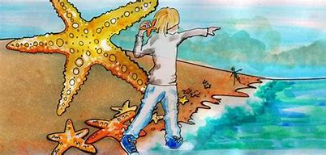

Slide 20
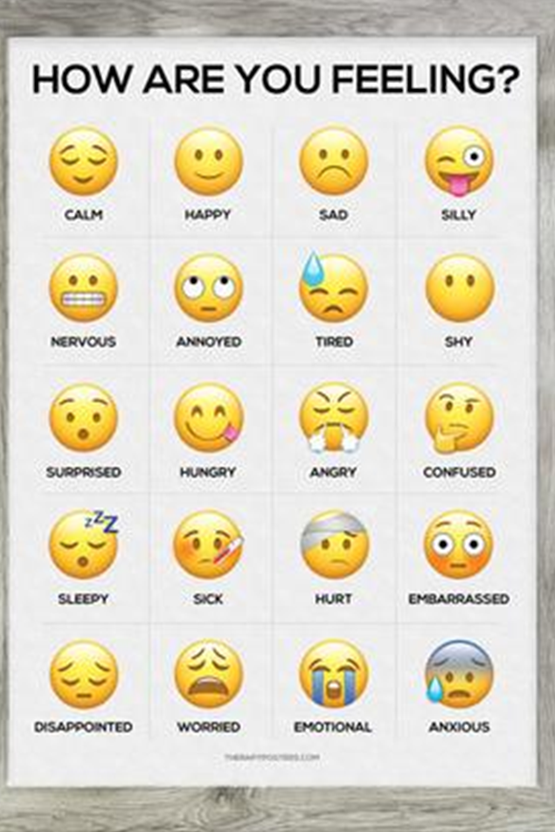
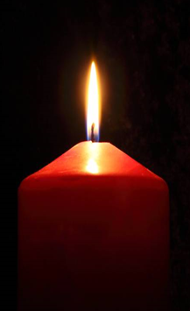
Pause for Thought…
We all feel different things at different times and that is perfectly normal.
It is important to look after both our physical and mental health, and support each other as well.
We can all make a difference to each other. We can help in many ways by talking, listening or doing something to help.
What can you do today?

Slide 22
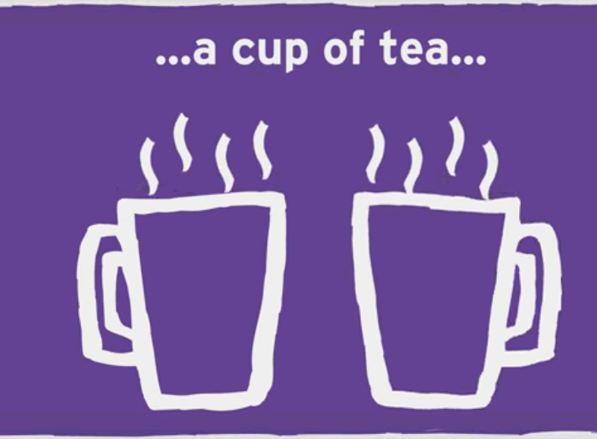
Make a difference today…
?
?
Notes:
Discuss with the person next to you:
What are 2 small things which might make a big difference to someone going through a tough time?

