Slide 1
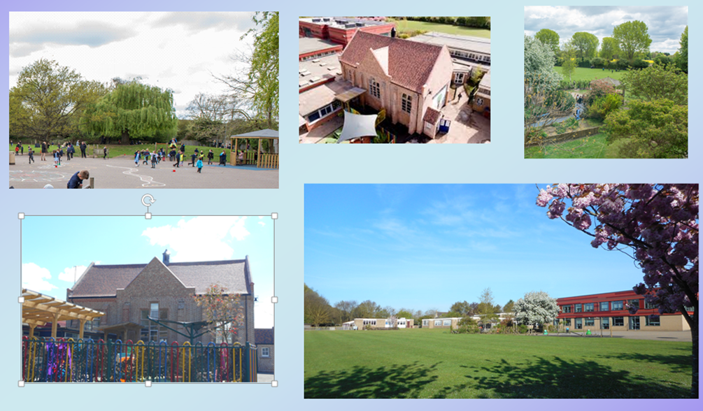
Welcome

Slide 2
How are you feeling?

Slide 4
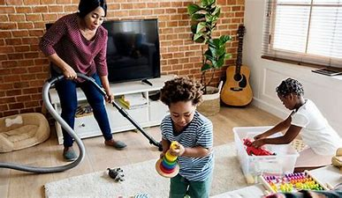
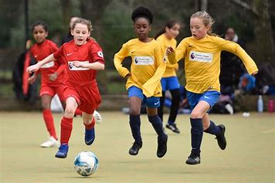
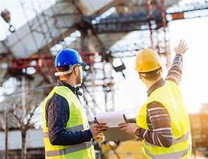
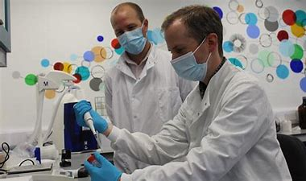
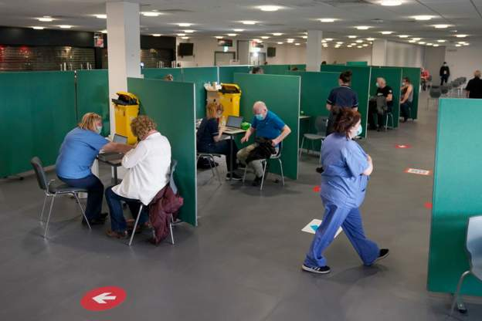
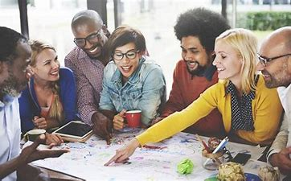
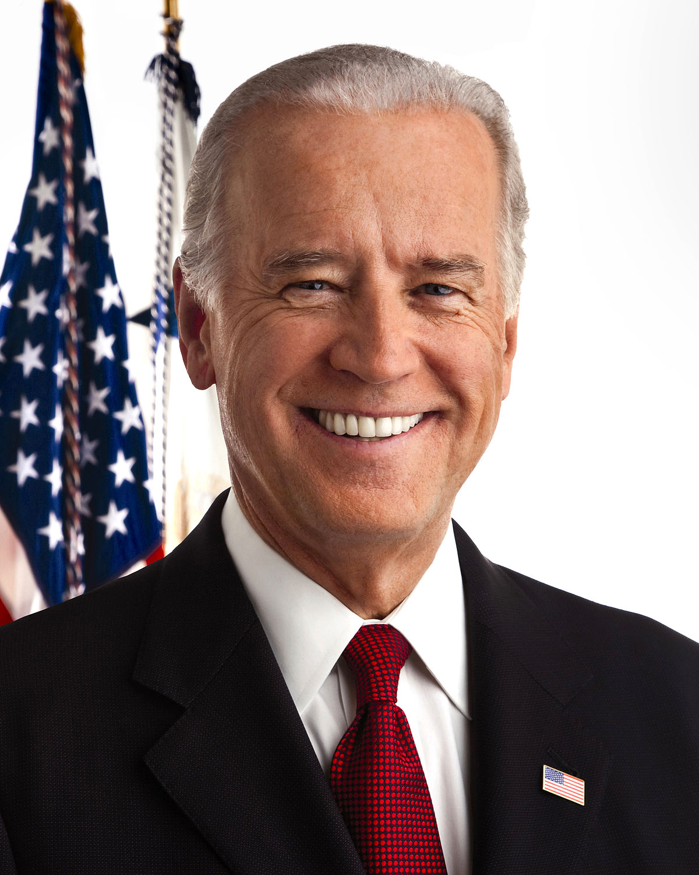
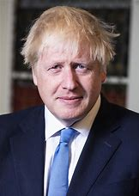

Slide 6
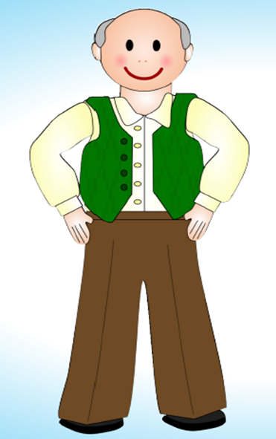

Slide 7
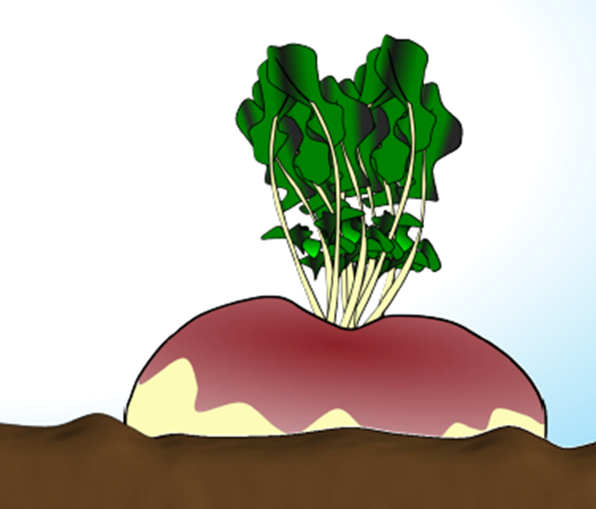
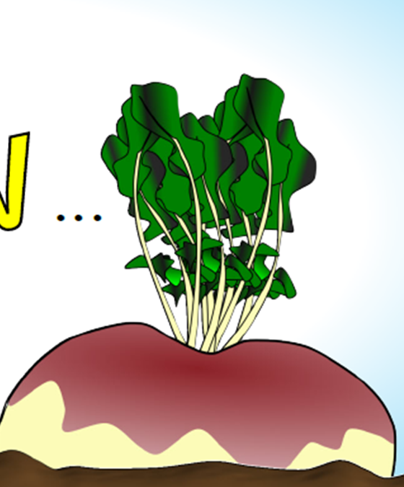

Slide 8
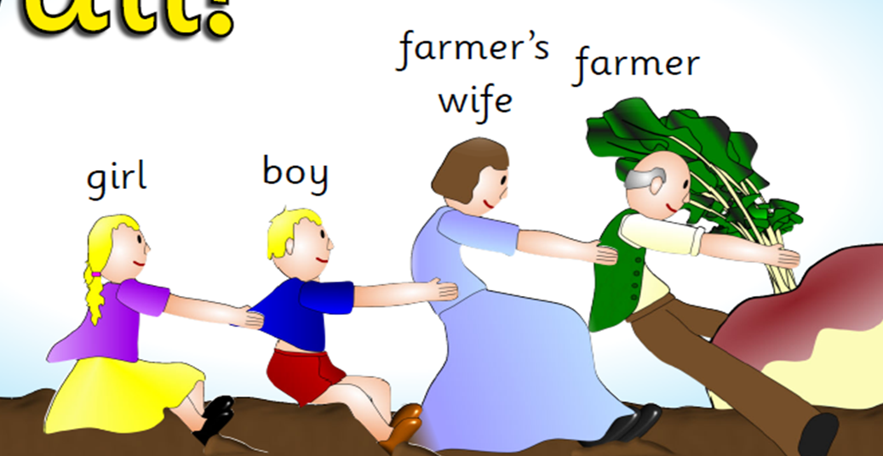

Slide 9
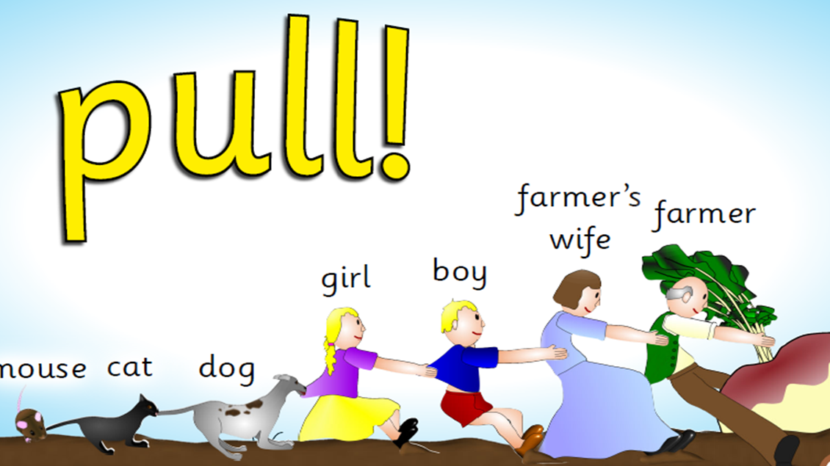

Slide 10
Which all goes to show that when everyone works TOGETHER, we can do things that you can’t do all by yourself!
POP!

Slide 12
Pause for Thought…
There are times when people need to do the same thing. In addition, many of us enjoy teamwork that is aimed at helping others or doing things together,
When we face a huge challenge or are faced with a big task, it’s important to pull together. Everyone’s effort is crucial and, just like the mouse in the story, the smallest help can make all the difference. Think about how you can work together with others today.
Think about the times when someone has done something that has helped you. Often, these are not enormous things: maybe someone helped you when you fell over or they have been kind to you when you were feeling sad. Try and do some little things which might make a big difference to other people.

Slide 13
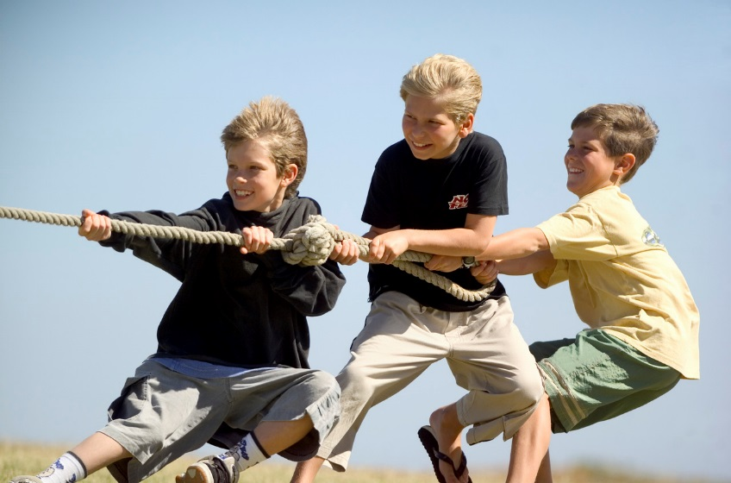
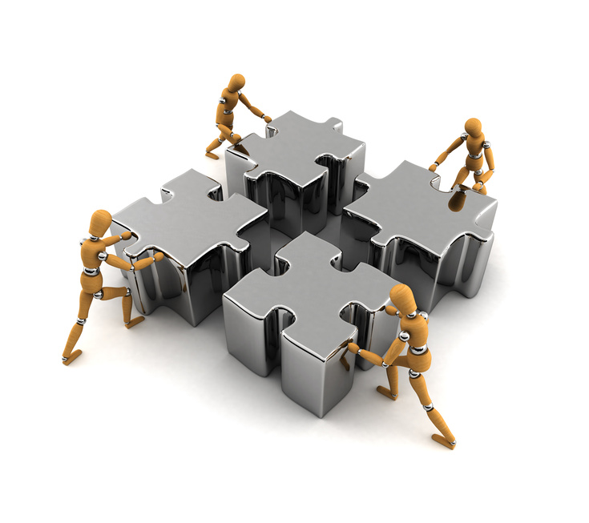
Together
Everyone
Achieves
More

